Slide 1
Verb Types
Timeline 434
Notes:
Final version-1

Slide 2
3 Verb Types
chocolate
vainilla
fresa
AR
ER
IR
Notes:
Life Timeline OK
PastPresentFuture = OK
PastPresentFuture = pieces
Past =OK
Float Out effect

Slide 3
3 Verb Trees
AR
ER
IR
Notes:
Life Timeline OK
PastPresentFuture = OK
PastPresentFuture = pieces
Past =OK
Float Out effect

Slide 4
3 Verb Trees
AR
ER
IR

Slide 5
3 Verb Trees
AR
ER
IR
????

Slide 6
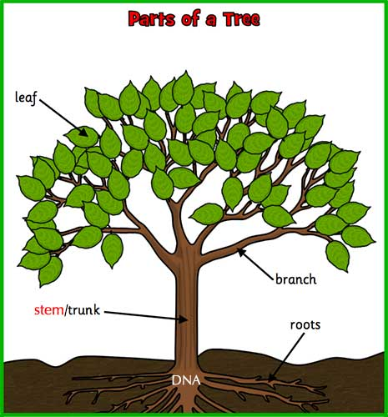
AR Verb Tree Present Tense
bailar = to dance
yo
tú
el, ella
usted
o
as
a
amos
an
nosotros
nosotras
ellos, ellas
ustedes
bail
bailo = I dance

Slide 7
3 Verb Trees
AR
ER
IR
o
as
a
amos
an
o
es
e
emos
en
o
es
e
imos
en
bailar
bail + ..….
comer
com + ..….
vivir
viv + ..….

Slide 8
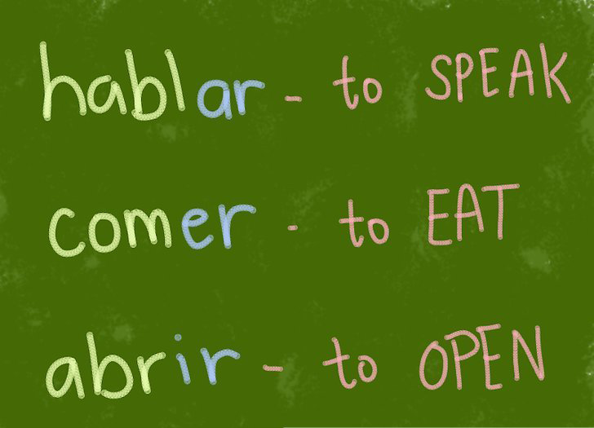
3 Verb Types
Notes:
Life Timeline OK
PastPresentFuture = OK
PastPresentFuture = pieces
Past =OK
Float Out effect

